Slide 1
Computer Architecture (EE 371 / CE 321 / CS 330)
Dr. Farhan Khan
Assistant Professor,
Dhanani School of Science & Engineering,
Habib University

Slide 2
Outline: Unit 1
Computer Architecture: The Big Picture
Defining Performance
Measuring Performance

Slide 3
Computer Engineering: The Big Picture
Process View
Structural View
Applications
Requirements
Specification
Operating System
Design
Computer Architecture
Digital Logic Circuits
Development
Transistors/ICs
Testing
Deployment / Operation

Slide 4
Computer Engineering: The Big Picture
Process View
Structural View
Applications
Requirements
Specification
Operating System
Design
Computer Architecture
Digital Logic Circuits
Development
Transistors/ICs
Testing
Deployment / Operation

Slide 5
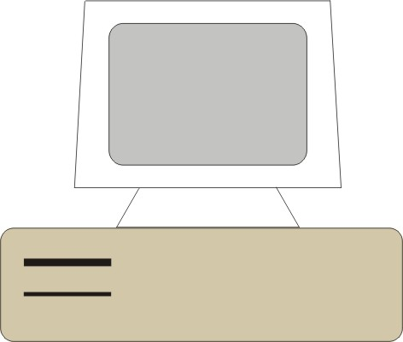
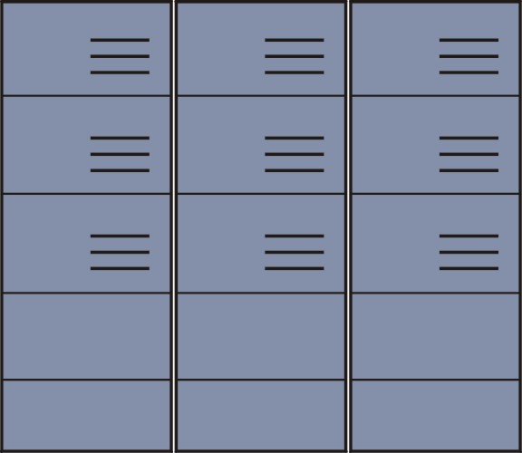

“Computer”: Examples
=
=
Cellphone
Workstation
Supercomputer

Slide 6
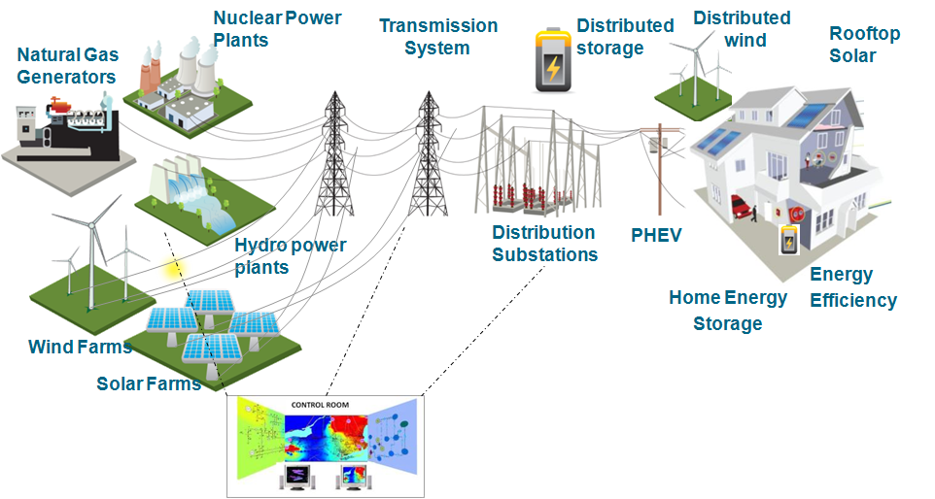

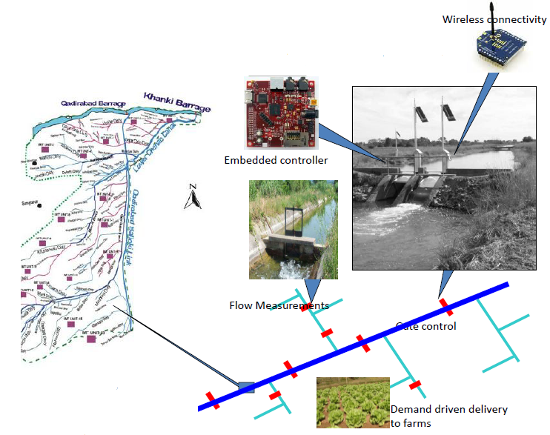
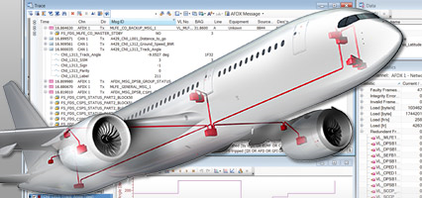
“Computer”: Examples
Smart Grid
Automotive
Smart Irrigation
Avionics

Slide 7
Computer Architecture: The Big Picture
Memory
Input
Output
Processor

Slide 8
Computer Architecture: The Big Picture
Memory
Input
(Keyboard,
Mouse)
Output
(LCD, Printer)
Processor

Slide 9
Computer Architecture: The Big Picture
Memory
Input
Output
Processor
Datapath
Control Unit
Control Unit:
Reads an instruction from the Memory
Interprets the instruction and generates signals that tell other components what to do

Slide 10
Computer Architecture: The Big Picture
Memory
Input
Output
Processor
Datapath
Control Unit
Control Unit:
“Clock” is a signal that keeps the Control Unit moving.
“1”
“0”
Clock Cycle
time→

Slide 11
Computer Architecture: The Big Picture
Memory
Input
Output
Summary:
Processor can execute instructions (such as “add two numbers” or “multiply two numbers”)
An instruction may take a certain number of clock cycles to complete
Processor
Datapath
Control Unit
“1”
“0”
Clock Cycle
time→

Slide 12
Computer Architecture: The Big Picture
Memory
Input
Output
Summary:
Processor can execute instructions (such as “add two numbers” or “multiply two numbers”)
An instruction may take a certain number of clock cycles to complete
Processor
Datapath
Control Unit
“1”
“0”
“Add”
“Multiply”
time→

Slide 13
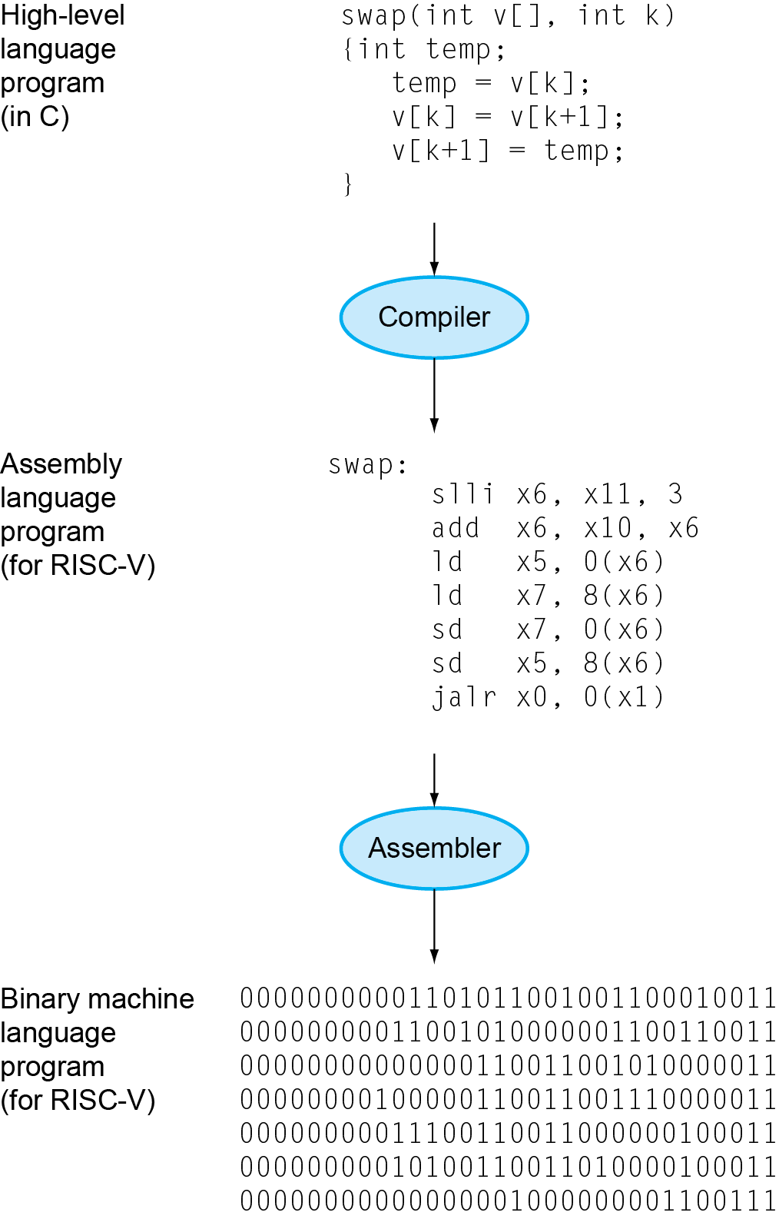
Computer Architecture: The Big Picture

Slide 14
Defining “Performance”
When we say one computer has better performance than another, what do we mean?

Slide 15
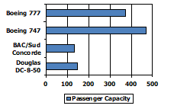
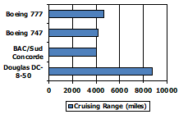
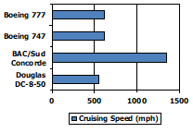
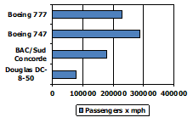
Defining “Performance”
Which airplane has the best performance?

Slide 16
Defining “Performance”
Individual User
Response Time / Execution Time
The time between start and completion of a task
Datacenter Manager
Throughput
The total amount of work done in a given time
For example, tasks/transactions per hour

Slide 17
Defining “Performance”
Individual User
Response Time / Execution Time
The time between start and completion of a task
Datacenter Manager
Throughput
The total amount of work done in a give time
For example, tasks/transactions per hour
We will need different performance metrics for personal mobile devices, which are more focused on response time, versus servers, which are more focused on throughput.

Slide 18
Interplay between “Response Time” and “Throughput”

Slide 19
Interplay between “Response Time” and Throughput

Slide 20
Defining “Performance”
Individual User
Response Time / Execution Time
The time between start and completion of a task
Datacenter Manager
Throughput
The total amount of work done in a give time
For example, tasks/transactions per hour
In this course, we will primarily be concerned with
Response Time / Execution Time as a measure of Performance
We will need different performance metrics for personal mobile devices, which are more focused on response time, versus servers, which are more focused on throughput.

Slide 21

Defining “Performance”
Performance of a Computer X is defined in terms of the execution time of a program on Computer X:
$$PerformanceX=\frac{1}{ExecutionTimeX}$$

Slide 22

Defining “Performance”
Performance of a Computer X is defined in terms of the execution time of a program on Computer X:
$$PerformanceX=\frac{1}{ExecutionTimeX}$$

Slide 23

Defining “Performance”
Performance of a Computer X is defined in terms of the execution time of a program on Computer X:
$$PerformanceX=\frac{1}{ExecutionTimeX}$$
Computer X is n times faster than Computer Y:

Slide 24
Measuring “Execution Time”
Elapsed time
Total response time, including all aspects
Processing, I/O, OS overhead, idle time
Determines system performance
CPU time
Time spent processing a given job
Discounts I/O time, other jobs’ shares
Comprises user CPU time and system CPU time

Slide 25
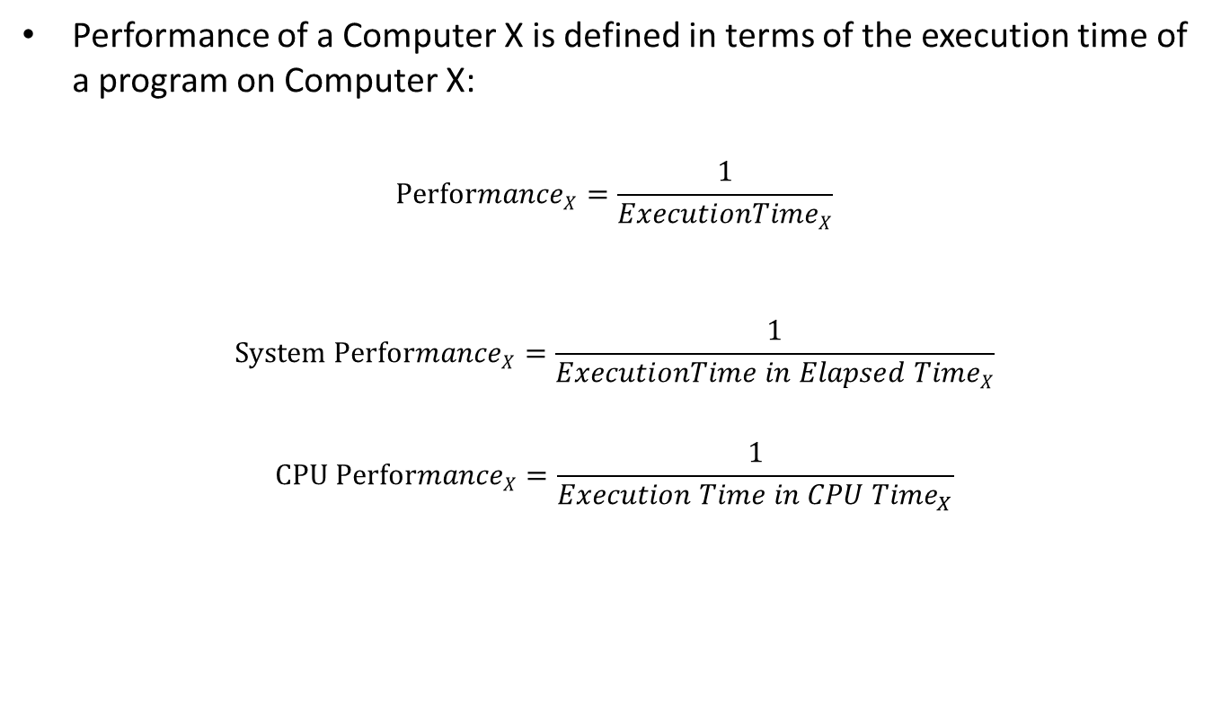
Defining “Performance”
Performance of a Computer X is defined in terms of the execution time of a program on Computer X:
$$PerformanceX=\frac{1}{ExecutionTimeX}$$
$$System PerformanceX=\frac{1}{ExecutionTime in Elapsed TimeX}$$
$$CPU PerformanceX=\frac{1}{{Execution Time in CPU Time}_{X}}$$

Slide 26
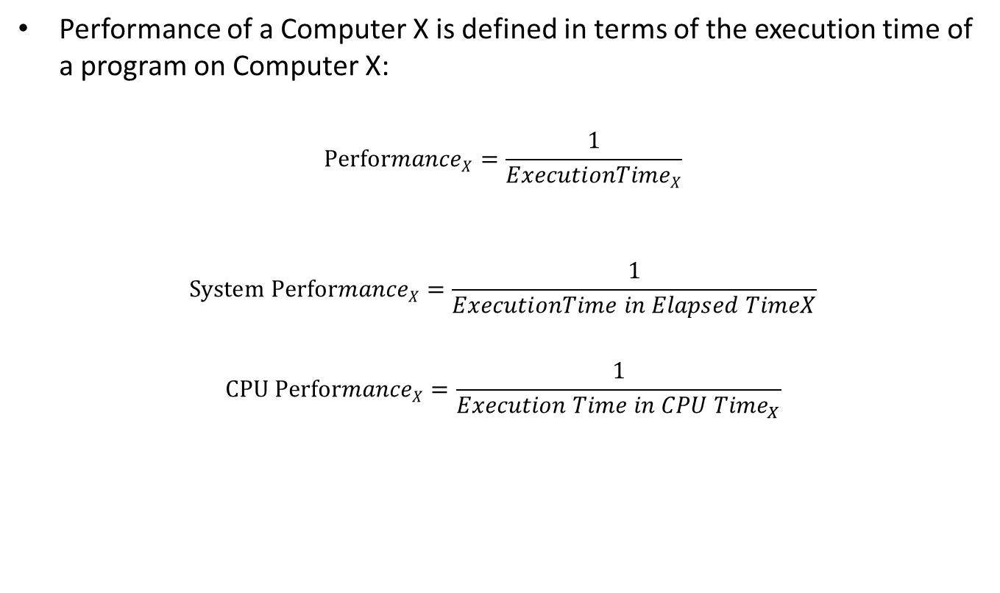
Defining “Performance”
Performance of a Computer X is defined in terms of the execution time of a program on Computer X:
$$PerformanceX=\frac{1}{ExecutionTimeX}$$
$$System PerformanceX=\frac{1}{ExecutionTime in Elapsed TimeX}$$
$$CPU PerformanceX=\frac{1}{{Execution Time in CPU Time}_{X}}$$
In this course, we will mostly focus on CPU Performance

Slide 27

Classical Performance Equation
Classical performance equation:
$$where$$
$Instruction Count=Number of machine instruction in a program$
$$CPI=Clock cycles per instruction$$
$$Clock cycle time= Clock Period=Time period of the clock signal$$

Slide 28
Classical Performance Equation
Memory
Input
Output
Processor
Datapath
Control Unit
“1”
“0”
“Add”
“Multiply”
time→

Slide 29
Classical Performance Equation
Memory
Input
Toy Example:
Instruction Count = 2 (1 add, 1 multiply)
Clock Cycles for Add instruction = 1
Clock Cycles for Multiply instruction = 2
CPI = (2+1)/2 = 1.5
Clock Period = 1 sec
CPU Time = Instruction Count x CPI x Clock Period
= 2 x 1.5 x 1
= 3 sec
Output
Processor
Datapath
Control Unit
“1”
“0”
“Add”
“Multiply”
time→

Slide 30
Improving Performance
Memory
Input
Toy Example:
Instruction Count = 2 (1 add, 1 multiply)
Clock Cycles for Add instruction = 1
Clock Cycles for Multiply instruction = 1
CPI = (1+1)/2 = 1
Clock Period = 1 sec
CPU Time = Instruction Count x CPI x Clock Period
= 2 x 1 x 1
= 2 sec
Output
Processor
Datapath
Control Unit
“1”
“0”
“Add”
“Multiply”
time→

Slide 31
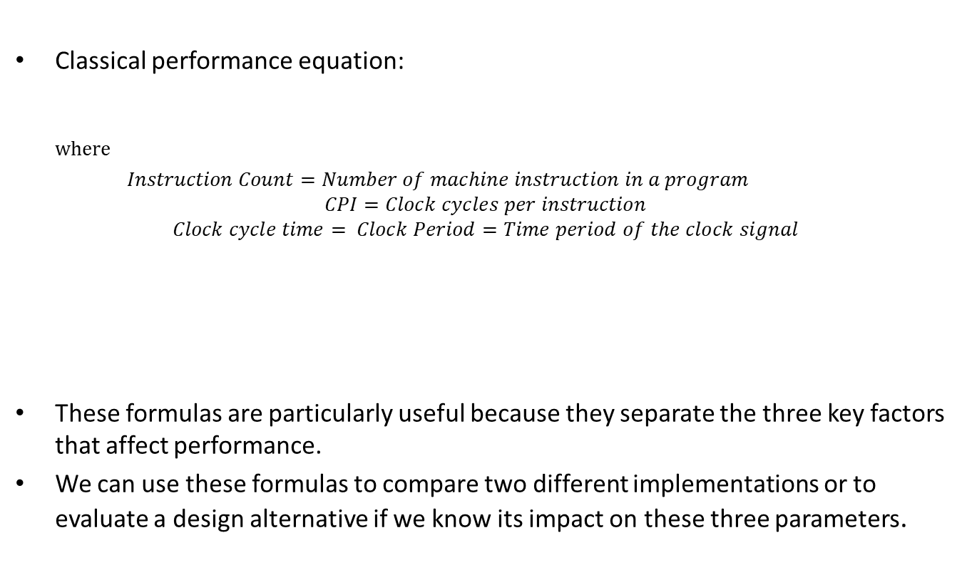
Classical Performance Equation
Classical performance equation:
$$where$$
$Instruction Count=Number of machine instruction in a program$
$$CPI=Clock cycles per instruction$$
$$Clock cycle time= Clock Period=Time period of the clock signal$$
These formulas are particularly useful because they separate the three key factors that affect performance.
We can use these formulas to compare two different implementations or to evaluate a design alternative if we know its impact on these three parameters.

Slide 32
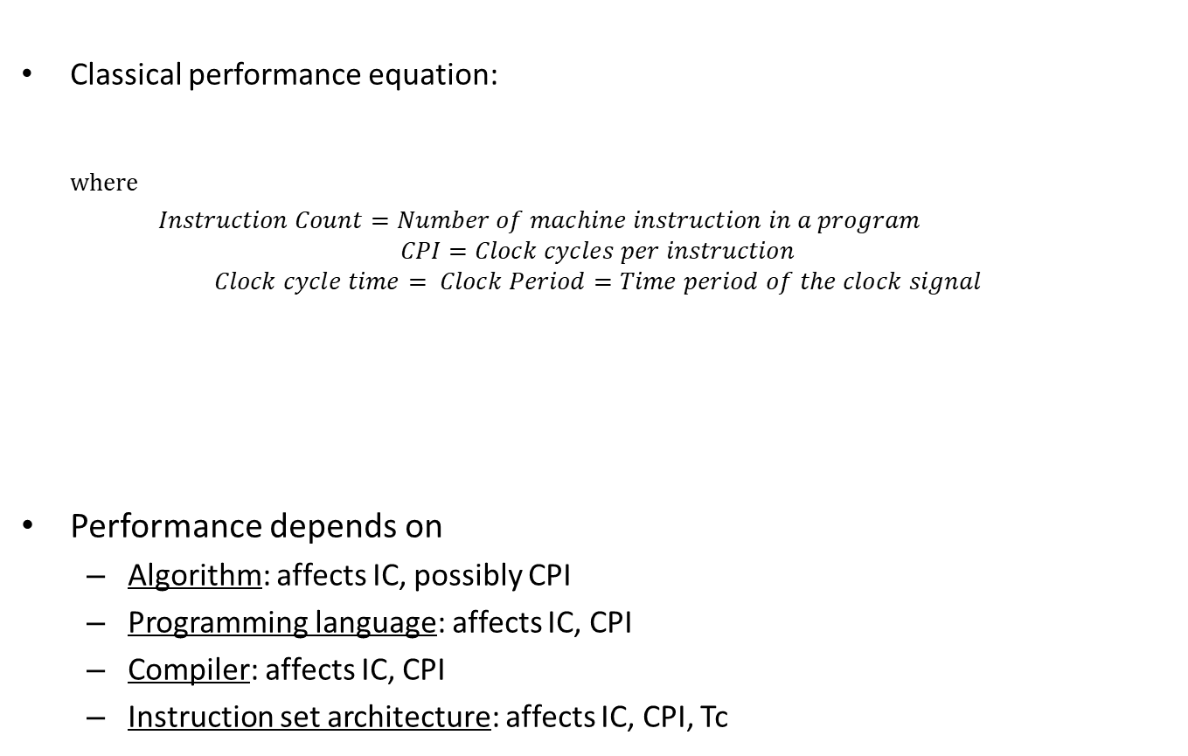
Classical Performance Equation
Classical performance equation:
$$where$$
$Instruction Count=Number of machine instruction in a program$
$$CPI=Clock cycles per instruction$$
$$Clock cycle time= Clock Period=Time period of the clock signal$$
Performance depends on
Algorithm: affects IC, possibly CPI
Programming language: affects IC, CPI
Compiler: affects IC, CPI
Instruction set architecture: affects IC, CPI, Tc

Slide 33
Instruction Set
Instruction Set
The vocabulary of instructions a computer can understand
Different Computers have different instruction sets
But with many common aspects
Examples
RISC-V
MIPS
Intel x86

Slide 34
Categories of RISC-V Instructions
Arithmetic
Data Transfer
Logical
Shift
Conditional Branch
Unconditional Branch

Slide 35
Arithmetic Instructions of RISC-V

Slide 36
The Two Camps: CISC vs RISC
Complex Instruction Set Computer
Reduced Instruction Set Computer
Includes multi-clock complex instructions
Memory-to-memory: LOAD and STORE incorporated in instructions
Small code sizes
Transistors used for storing complex instructions
Intel x86
Example:
MULT M[5],M[3],M[2]
Single-clock, reduced instruction only
Register to register: "LOAD" and "STORE“ are independent instructions
Large code sizes
Spends more transistors on memory registers
RISC-V, MIPS, ARM, PowerPC
Example:
LOAD R1,M[3] LOAD R2,M[2] MUL R3,R1,R2 STORE M[5],R3

Slide 37
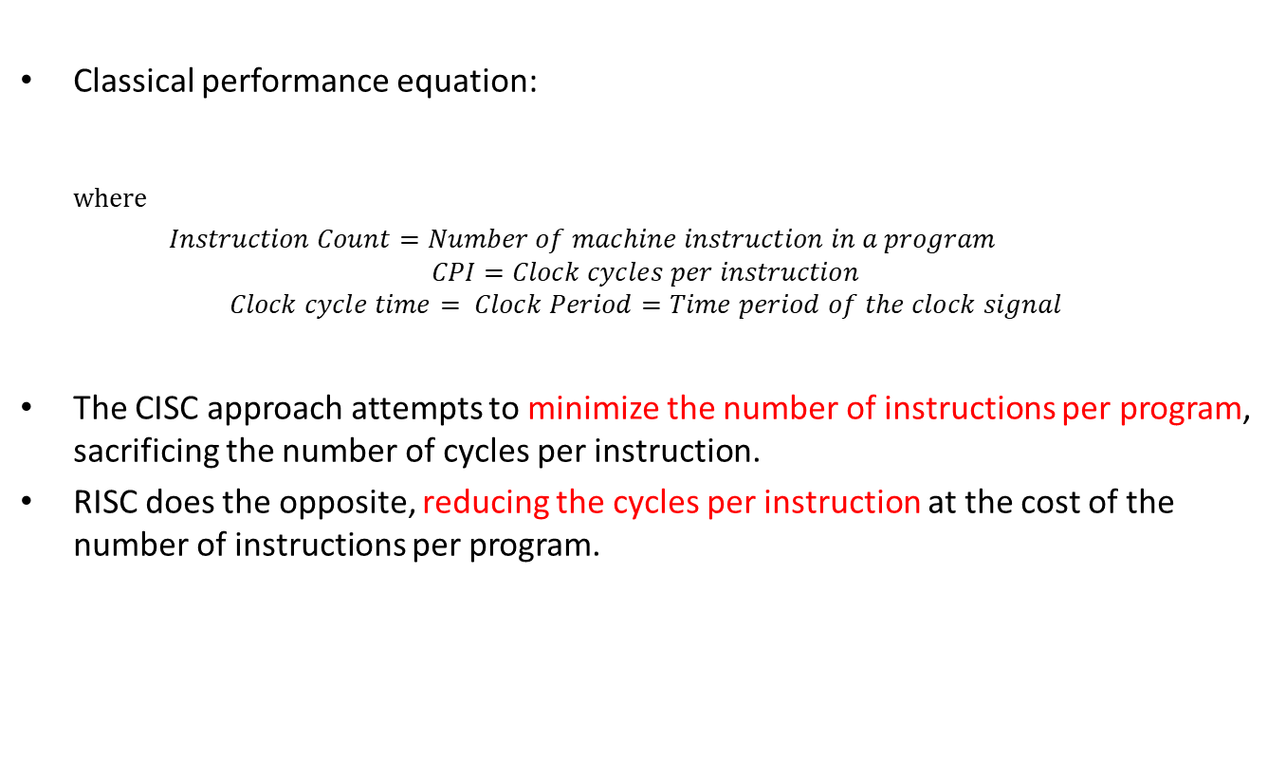
CISC vs RISC
Classical performance equation:
$$where$$
$Instruction Count=Number of machine instruction in a program$
$$CPI=Clock cycles per instruction$$
$$Clock cycle time= Clock Period=Time period of the clock signal$$
The CISC approach attempts to minimize the number of instructions per program, sacrificing the number of cycles per instruction.
RISC does the opposite, reducing the cycles per instruction at the cost of the number of instructions per program.

Slide 38
Example

Slide 39
Example

Slide 40
Example

Slide 41
Example

Slide 42
Example

